Slide 1
1D Thermal+Ablation Sim
Elliott McKee
Team: Sim Gang
Advisor: Dr. Nabity

Slide 2
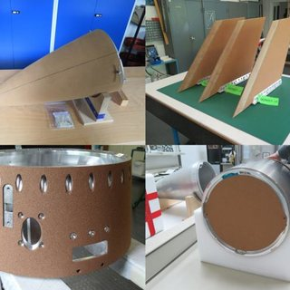
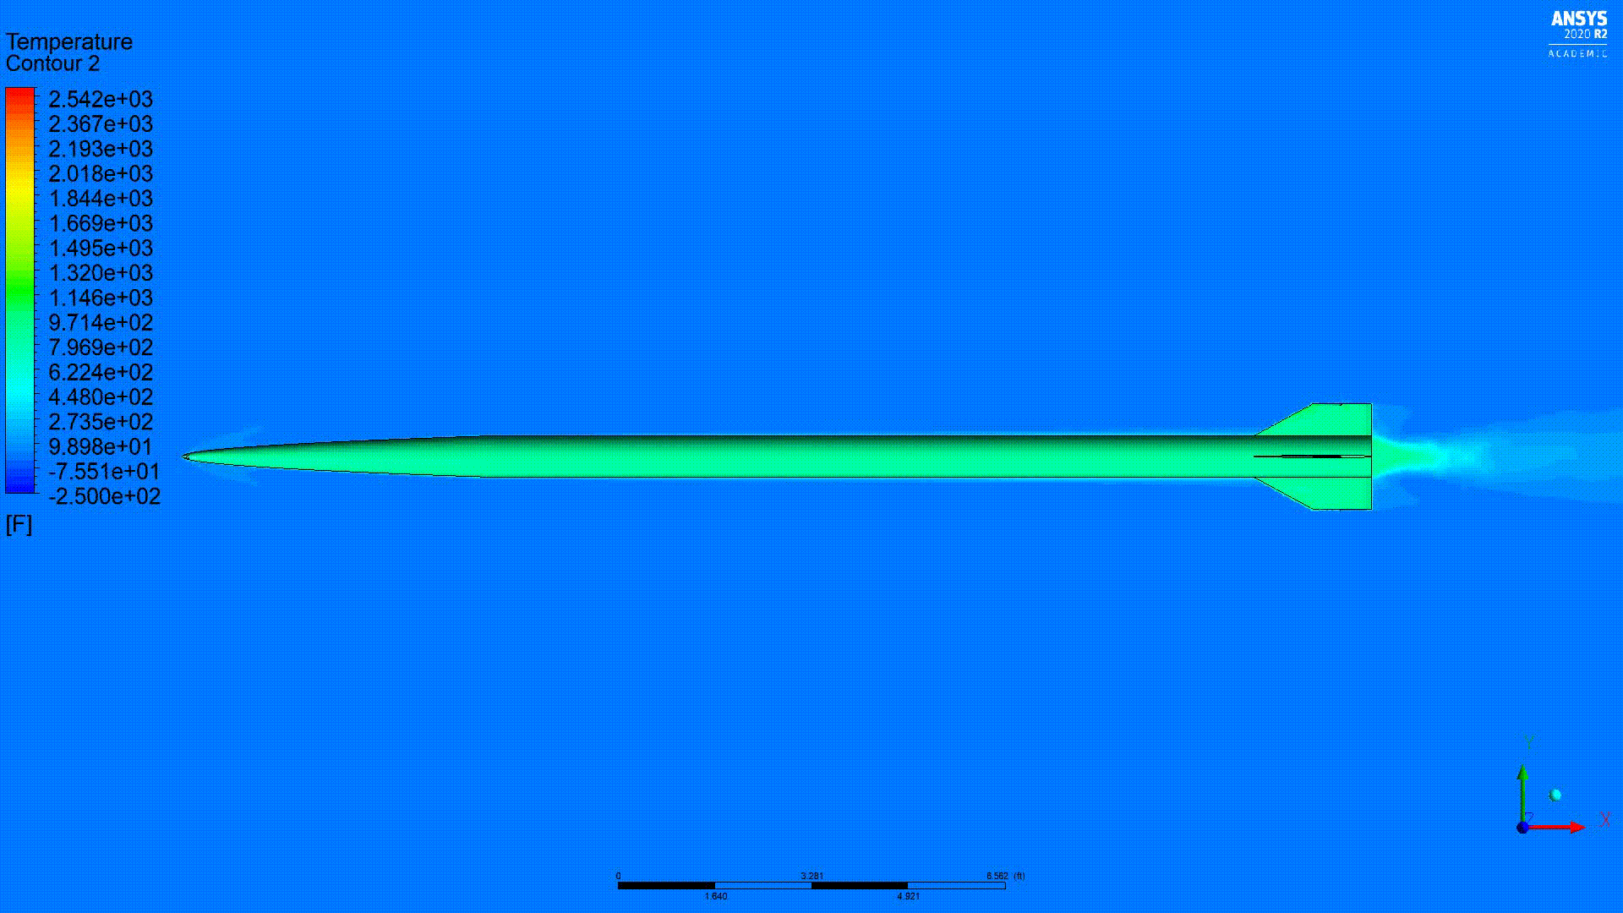
Project Goals
Objective:
More rigorous Aerothermal modelling for thermal analysis of general rockets.
Begin implementation of rudimentary (tractable) ablation analysis for use in the design and analysis of thermal protection systems.
How will it be used in design:
Allows the user to hand it a flight profile and wall configuration, and get back relevant thermal data.
Much quicker than any sort of CFD modelling
Most CFD solvers can’t handle ablation easily
Notes:
More Rigorous Analysis:
Wall temps, Fin design, interior temp estimates for Yonix
Begin Implementation:
Spurred by hearing that we are likely going to need TPS for a Spaceshot vehicle- May be early, but this seems like a fairly involved process to actually put engineering analysis into (and an easy thing to do remote, for the time being). Kinda the reasoning behind why I have cared enough to jump on this so early.

Slide 3
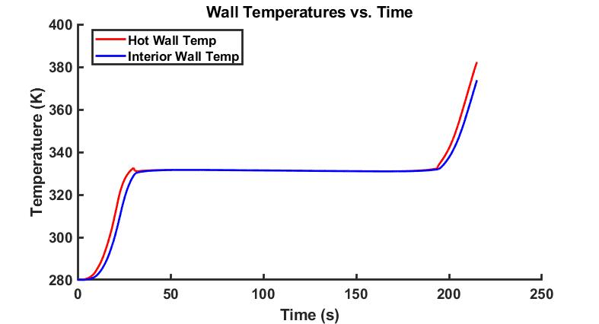
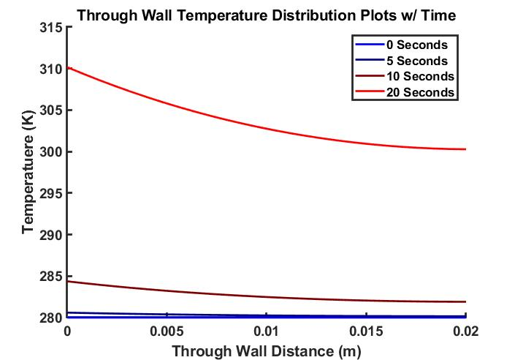
What it is
Example Output Data
This is a Matlab Script that
Inputs:
Wall Configuration
Materials + Thicknesses
Downstream evaluation location
Measured downstream of nosecone
Flight Profile
OpenRocket, RAS, PythonSim, etc.
Outputs:
Simulated Thermal Data throughout Flight
Through-wall Temperature data at evaluation location, w/ time
Surface Recession, Bond-Line temperatures, and more for Ablatives

Slide 4
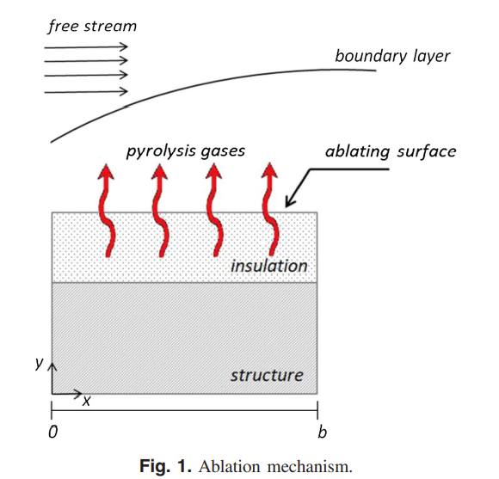
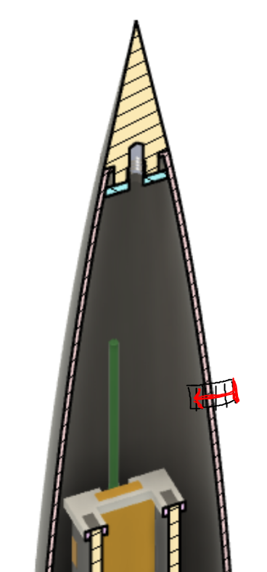
Capabilities
Free-Stream
Wall Configurations:
Structural Wall only
Ablative Wall only
Ablative + Structural Wall*
Flight Profiles:
Can use any flight sim data from any of the flight sim softwares we have
Ablation
Currently can handle charring ablators
Limitations
Pretty much nosecones, and tubes for time being
No stagnation point heating
Could likely be extended to fins
1-Dimensional Heat Transfer
Only Through-Wall Heat Transfer is considered
Ablative+Structural Configuration
“Through-Wall”

Slide 5
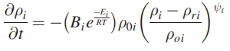
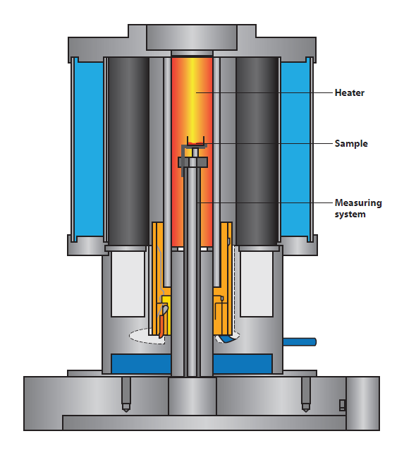
Required Material inputs for Ablation
Nothing out of the ordinary required for analysis of structural walls made of isotropic materials
For ablative materials, the Arrhenius reaction coefficients are required
“Often” can be found in literature
Can be found experimentally via Thermogravimetric Analysis
I currently have found values in literature for a few common composites like Carbon-Phenolic, somewhat incomplete values for Phenolic Impregnated Carbon Ablative (PICA), and values for P-50 Cork

Slide 6
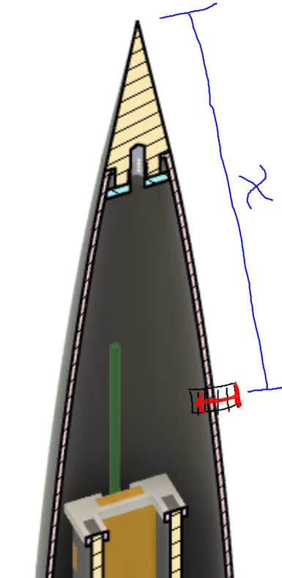
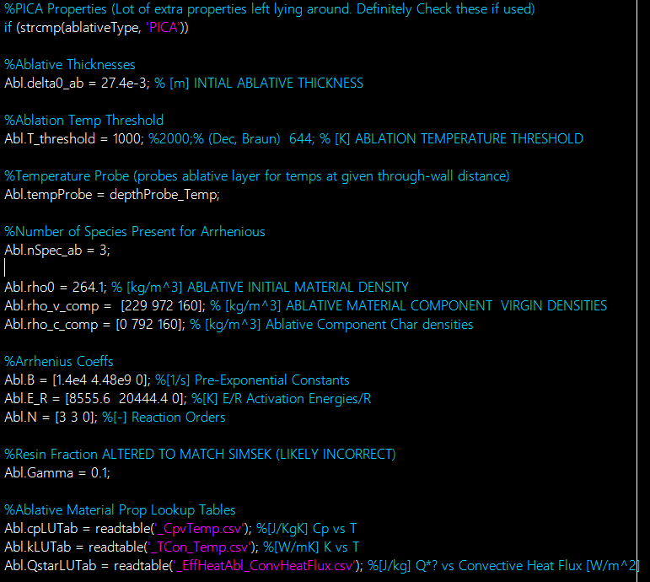
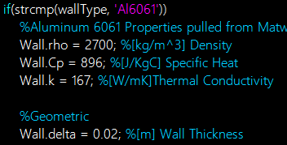
Usage
User must specify:
Downstream X location to evaluate
Material Properties/Configuration
For Structural
Density, Specific Heat, Thermal Conductivity
For Ablative
Above plus; Ablation Threshold Temp, component densities and Arrhenius coeffs, Resin Fraction
Flight Simulation Data Filepath
Outputs
Simulated Temperature distribution data throughout flight profile
Ablative Material Performance

Slide 7
Technical Section Outline
Project Background
Simulation Methodology
Theory
Verification & Validation
Final Thoughts
Project Background
Source
Ablation Phenomenon
4. Verification and Validation of Software
Arcjet Ablative Verification
Aerothermal Verification
Hifire-5
Hifire-5B
2. Simulation Methodology
Time+Space Discretization
3. Theory
One-Dimensional Heat Transfer
Aerothermal Modelling
Ablation Modelling
5. Final Discussion
Status
Future Improvements

Slide 8
Project Background
Project Background
Simulation Methodology
Theory
Verification & Validation
Final Thoughts
Project Background
Source
Ablation Phenomenon
4. Verification and Validation of Software
Arcjet Ablative Verification
Aerothermal Verification
Hifire-5
Hifire-5B
2. Simulation Methodology
Time+Space Discretization
3. Theory
One-Dimensional Heat Transfer
Aerothermal Modelling
Ablation Modelling
5. Final Discussion
Status
Future Improvements

Slide 9
Project Background
Project Background
Simulation Methodology
Theory
Verification & Validation
Final Thoughts
Most of the analysis is based on the following paper:
One-Dimensional Aerodynamic Heating and Ablation Prediction (Uslu, Simsek, 2019)
Many other papers required to piece together full picture
Credit to Owen Kaufmann on the initial find and initial implementation

Slide 10
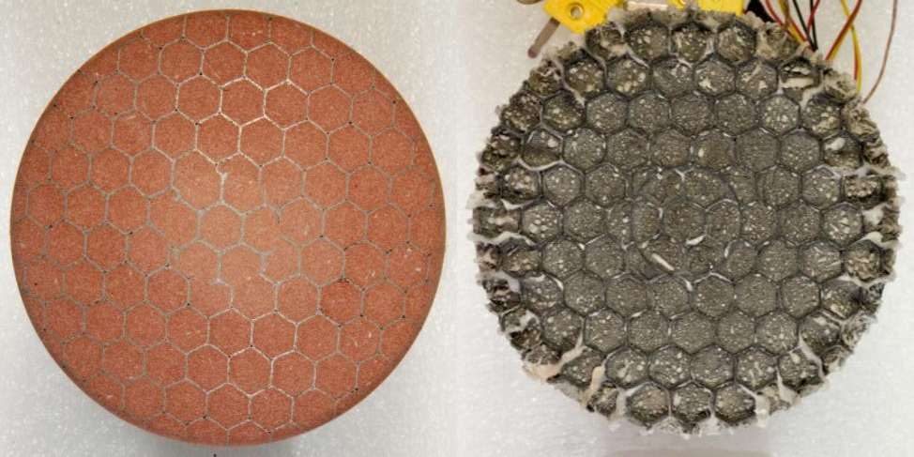
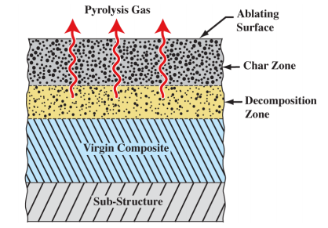
Ablation Definition + Processes
Project Background
Project Background
Simulation Methodology
Simulation Methodology
Theory
Theory
Verification & Validation
Verification & Validation
Final Thoughts
Final Thoughts
Ablation Definition
“In space physics, ablation is the process of absorbing energy by removal of surface material by melting, vaporization, sublimation, or chemical reaction”
Sacrificial Thermal Rejection
Absorbs heat, resin vaporizes, gas ejected to surroundings
Char Zone is Porous, allows gases generated in decomposition zone to escape
Mass flux into the boundary layer reduces heat transfer
Phenomenon called: Blowing
Contributions from:
Pyrolysis Gasses
Ablating surface
Schematic of a Charring Ablator
Image: Overview of the CHarring Ablator Response (CHAR) Code

Slide 11
Project Background
Project Background
Simulation Methodology
Theory
Verification & Validation
Final Thoughts
Project Background
Source
Ablation Phenomenon
4. Verification and Validation of Software
Arcjet Ablative Verification
Aerothermal Verification
Hifire-5
Hifire-5B
2. Simulation Methodology
Time+Space Discretization
3. Theory
One-Dimensional Heat Transfer
Aerothermal Modelling
Ablation Modelling
5. Final Discussion
Status
Future Improvements

Slide 12
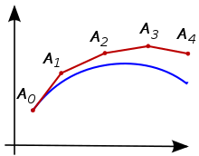
Simulation Methods
Project Background
Project Background
Project Background
Project Background
Simulation Methodology
Simulation Methodology
Simulation Methodology
Simulation Methodology
Theory
Theory
Theory
Theory
Verification & Validation
Verification & Validation
Verification & Validation
Verification & Validation
Final Thoughts
Final Thoughts
Final Thoughts
Final Thoughts
Elements or Nodes
Finite Difference Thermal Modelling
Wall is discretized into individual nodes. Governing equations are discretized explicitly for each node
Forward time-stepping (Euler) integration
Rates of change of the temperature are determined at each discrete time point, then integrated forward by multiplying by the time-step size
Accuracy is dependent on the resolution of the time+spatial discretizations
If either is too coarse, solution will diverge
Stability Criterion implemented
Notes:
Super high level flowchart of inputs and outputs

Slide 13
Project Background
Project Background
Project Background
Simulation Methodology
Simulation Methodology
Theory
Theory
Verification & Validation
Verification & Validation
Final Thoughts
Final Thoughts
Project Background
Source
Ablation Phenomenon
4. Verification and Validation of Software
Arcjet Ablative Verification
Aerothermal Verification
Hifire-5
Hifire-5B
2. Simulation Methodology
Time+Space Discretization
3. Theory
One-Dimensional Heat Transfer
Aerothermal Modelling
Ablation Modelling
5. Final Discussion
Status
Future Improvements

Slide 14
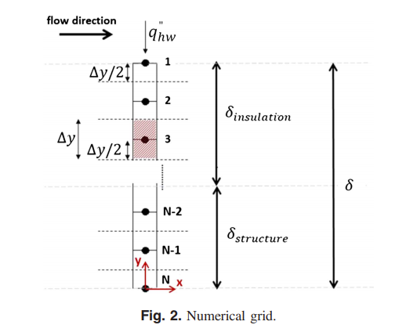
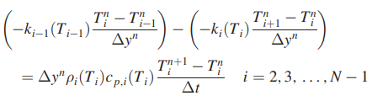
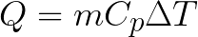
Theory- One-Dimensional, Finite Difference Heat Transfer
Project Background
Project Background
Project Background
Project Background
Project Background
Simulation Methodology
Simulation Methodology
Simulation Methodology
Simulation Methodology
Simulation Methodology
Theory
Theory
Theory
Theory
Theory
Verification & Validation
Verification & Validation
Verification & Validation
Verification & Validation
Verification & Validation
Final Thoughts
Final Thoughts
Final Thoughts
Final Thoughts
Final Thoughts
One-Dimensional, through-wall heat transfer only
Entire wall is discretized into a grid, with n elements/nodes
“The governing heat transfer equations are discretized explicitly for each node”
Rate of change of the temperature of an interior element is a function of the temperatures of adjacent nodes, and the material Thermal Conductivity
Exposed wall temperature is a function of the “Hot Wall” heat flux
Inner wall temp currently Adiabatic (no heat transfer at this boundary)
Compare to:
Notes:
DEFINE ONE DIMENSIONAL

Slide 15
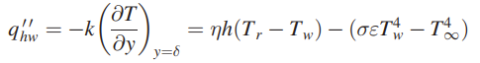
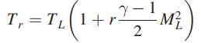
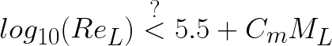
Theory- Aerothermal Heating Pt. 1
Project Background
Project Background
Project Background
Project Background
Project Background
Project Background
Simulation Methodology
Simulation Methodology
Simulation Methodology
Simulation Methodology
Simulation Methodology
Simulation Methodology
Theory
Theory
Theory
Theory
Theory
Theory
Verification & Validation
Verification & Validation
Verification & Validation
Verification & Validation
Verification & Validation
Verification & Validation
Final Thoughts
Final Thoughts
Final Thoughts
Final Thoughts
Final Thoughts
Final Thoughts
Determine local flow properties (outside boundary layer), for a supersonic vehicle using wedge shock relations
Recovery Temperature, T_{r}, is a function of the local flow properties, and the recovery factor, r
r is a function of the flow Prandtl No. Slightly differs between Laminar and Turbulent flow
Laminar-Turbulent Transition
Empirically derived relationship for determining Laminar-Turbulent Transition

Slide 16
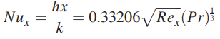
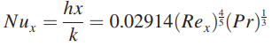
Theory- Aerothermal Heating Pt. 2
Project Background
Project Background
Project Background
Project Background
Project Background
Project Background
Simulation Methodology
Simulation Methodology
Simulation Methodology
Simulation Methodology
Simulation Methodology
Simulation Methodology
Theory
Theory
Theory
Theory
Theory
Theory
Verification & Validation
Verification & Validation
Verification & Validation
Verification & Validation
Verification & Validation
Verification & Validation
Final Thoughts
Final Thoughts
Final Thoughts
Final Thoughts
Final Thoughts
Final Thoughts
The heat transfer for a flat plate are determine for Laminar and Turbulent flow, respectively, with the following
Laminar:
Turbulent:
These are then corrected with a factor of sqrt(3) to apply to axisymmetric, conical boundary layers (Böhrk et al. (2014))
The fluid properties (thermal conductivity, viscosity, etc.) very significantly throughout the boundary layer, due to large changes in temperature.
Eckert Reference Temperature:
Thermal conductivity, viscosity, etc., are then calculated using Sutherland equations.

Slide 17
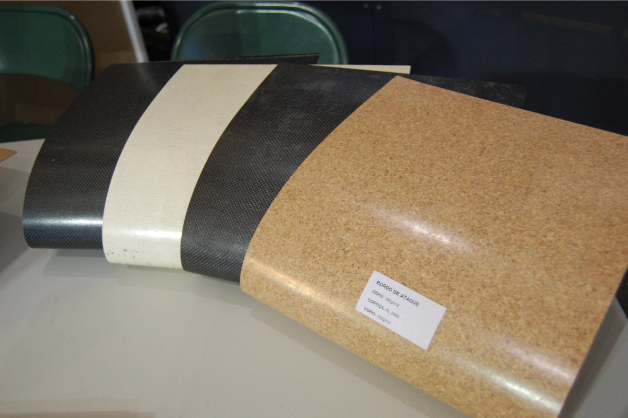
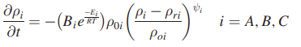
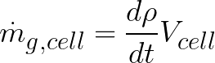
Theory- Ablation/Pyrolysis modelling
Project Background
Project Background
Project Background
Project Background
Project Background
Project Background
Simulation Methodology
Simulation Methodology
Simulation Methodology
Simulation Methodology
Simulation Methodology
Simulation Methodology
Theory
Theory
Theory
Theory
Theory
Theory
Verification & Validation
Verification & Validation
Verification & Validation
Verification & Validation
Verification & Validation
Verification & Validation
Final Thoughts
Final Thoughts
Final Thoughts
Final Thoughts
Final Thoughts
Final Thoughts
Charring ablators are composites, and consist of multiple material components
In the following equations, A & B are resin components, which decompose. C is reinforcement material, which generally does not
Temperature dependance of Pyrolysis of each component is modelled using an Arrhenius relation:
Total material density is calculated using the resin volume fraction, 𝚪
Through conservation of mass, and the above equations, we can determine the rate at which gas is being generated by the Pyrolysis reaction, based on how much the solid material is decomposing.
Summing the contributions of all the cells gives the total Pyrolysis gas generation at a given time step
Temperature Dependent Term
Reaction Progress Term

Slide 18
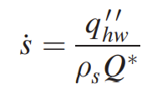
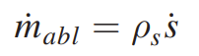
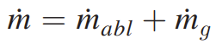
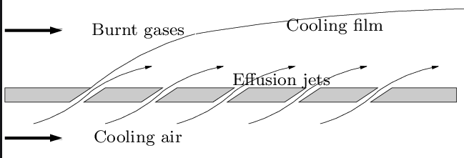
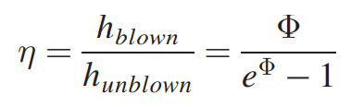
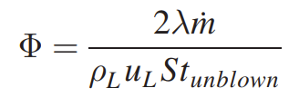
Theory- Surface Ablation and Blowing Factor
Project Background
Project Background
Project Background
Project Background
Project Background
Project Background
Simulation Methodology
Simulation Methodology
Simulation Methodology
Simulation Methodology
Simulation Methodology
Simulation Methodology
Theory
Theory
Theory
Theory
Theory
Theory
Verification & Validation
Verification & Validation
Verification & Validation
Verification & Validation
Verification & Validation
Verification & Validation
Final Thoughts
Final Thoughts
Final Thoughts
Final Thoughts
Final Thoughts
Final Thoughts
In addition to Pyrolysis gas generation, surface ablation also injects mass into the boundary layer.
Surface Recession is modelled using the hot wall heat flux, q’’, the material surface density, 𝜌_{s} , and the material heat of ablation, Q*
The total mass flow rate out of the surface material is described by:
This total mass flow rate is then used to correct the hot wall heat flux,
mass injection into the boundary layer reduces the overall heat transfer (compare to film cooling)

Slide 19
Project Background
Project Background
Project Background
Simulation Methodology
Simulation Methodology
Theory
Theory
Verification & Validation
Verification & Validation
Final Thoughts
Final Thoughts
Project Background
Source
Ablation Phenomenon
4. Verification and Validation of Software
Arcjet Ablative Verification
Aerothermal Verification
Hifire-5
Hifire-5B
2. Simulation Methodology
Time+Space Discretization
3. Theory
One-Dimensional Heat Transfer
Aerothermal Modelling
Ablation Modelling
5. Final Discussion
Status
Future Improvements

Slide 20
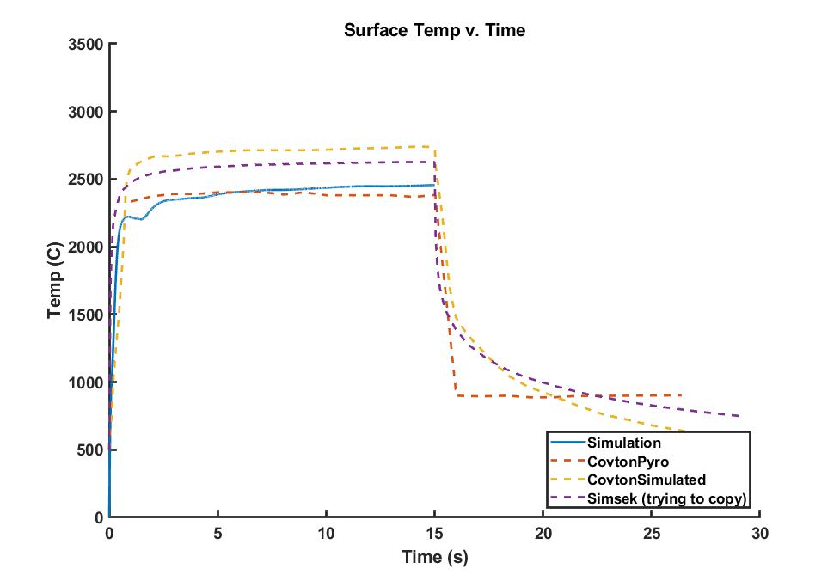
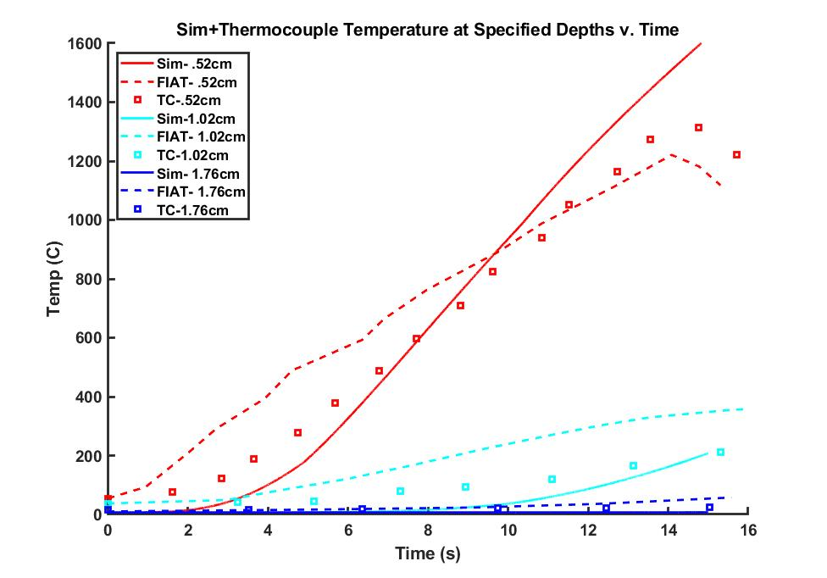
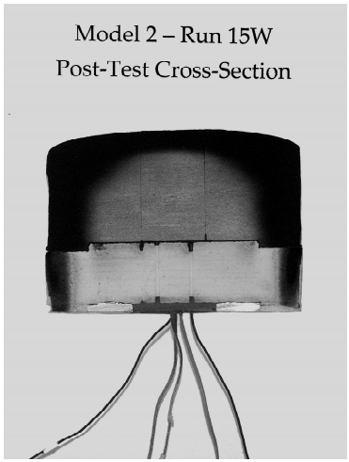
V&V- Ablation Model (Arcjet)
Project Background
Project Background
Project Background
Project Background
Project Background
Project Background
Simulation Methodology
Simulation Methodology
Simulation Methodology
Simulation Methodology
Simulation Methodology
Simulation Methodology
Theory
Theory
Theory
Theory
Theory
Theory
Verification & Validation
Verification & Validation
Verification & Validation
Verification & Validation
Verification & Validation
Verification & Validation
Final Thoughts
Final Thoughts
Final Thoughts
Final Thoughts
Final Thoughts
Final Thoughts
Arcjet testing is commonly used for analysis of ablative materials
Arcjet test data is included in Uslu-Simsek, based on tests performed by Covington (2004).
Material: PICA
Flow Total Enthalpy: 29.5 MJ/Kg
Exposure Time: 15s
Results
Total Recession
 | Total Recession | Relative Error From Experimental
Covington (Experimental) | 2.70 mm
Uslu-Simsek | 2.56 mm | -5.22%
Simulated | 3.20 mm | 18.5%

Slide 21
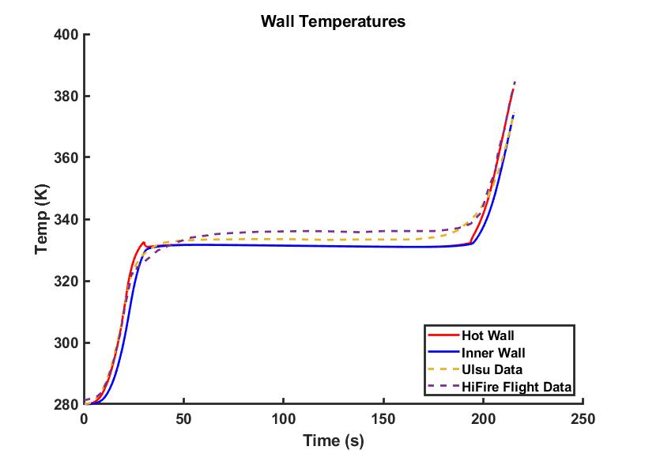
V&V- Aerothermal Heating (HiFire Flight Data)
Project Background
Project Background
Project Background
Project Background
Project Background
Project Background
Project Background
Simulation Methodology
Simulation Methodology
Simulation Methodology
Simulation Methodology
Simulation Methodology
Simulation Methodology
Simulation Methodology
Theory
Theory
Theory
Theory
Theory
Theory
Theory
Verification & Validation
Verification & Validation
Verification & Validation
Verification & Validation
Verification & Validation
Verification & Validation
Verification & Validation
Final Thoughts
Final Thoughts
Final Thoughts
Final Thoughts
Final Thoughts
Final Thoughts
Final Thoughts
HiFire-5 is a Sounding Rocket with the goal of investigating high-supersonic/ hypersonic Aerothermodynamics.
Payload consists Elliptical Cone, with a wealth of thermocouples, heat flux sensors, and pressure gauges
Only reached Mach ~3 due to second stage failure to ignite
Material: 6061 Aluminum (Non-ablating)
Strong agreement between experimental, Ulsu-Simsek, and simulations serve to help verify the Aerothermal modelling.
Notes:
REMOVE PLOTS

Slide 22
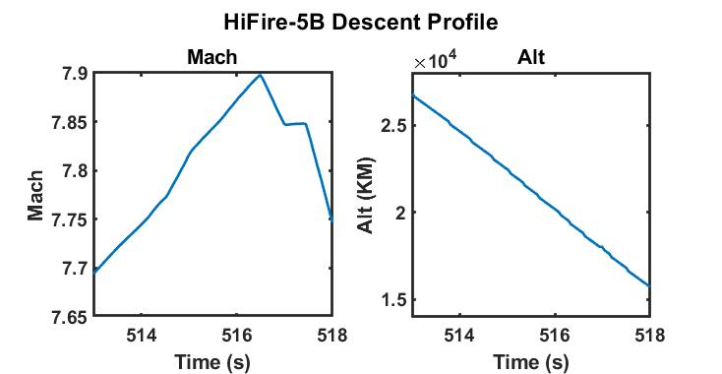
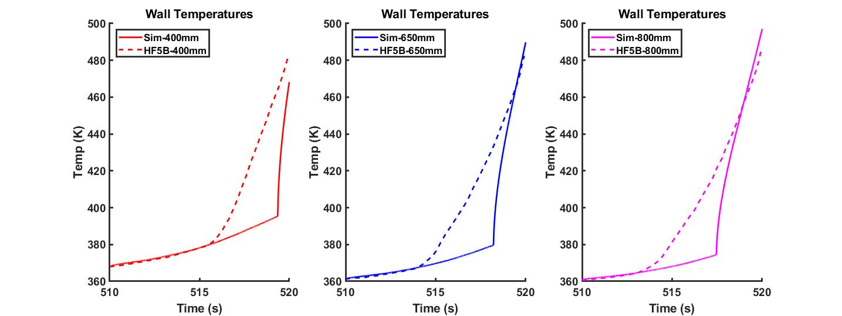
V&V- Aerothermal Heating (HiFire-5B Flight Data)
Project Background
Project Background
Project Background
Project Background
Project Background
Project Background
Project Background
Simulation Methodology
Simulation Methodology
Simulation Methodology
Simulation Methodology
Simulation Methodology
Simulation Methodology
Simulation Methodology
Theory
Theory
Theory
Theory
Theory
Theory
Theory
Verification & Validation
Verification & Validation
Verification & Validation
Verification & Validation
Verification & Validation
Verification & Validation
Verification & Validation
Final Thoughts
Final Thoughts
Final Thoughts
Final Thoughts
Final Thoughts
Final Thoughts
Final Thoughts
HiFire-5B is the same as the HiFire-5, but the second stage lit correctly, and achieved nearly Mach 8 on descent
Little ascent data is readily available from the reports, so the descent data is used instead.
Relatively short time range where data is available (<10 seconds)
Material: 6061 Aluminum (Non-ablating)
Sharp corner in Simulation results is due to the laminar-turbulent transition modelling
Strong agreement in the laminar region
Unfortunate that there is not more data to see how well the turbulent heat transfer matches

Slide 23
Project Background
Project Background
Project Background
Simulation Methodology
Simulation Methodology
Theory
Theory
Verification & Validation
Verification & Validation
Final Thoughts
Final Thoughts
Project Background
Source
Ablation Phenomenon
4. Verification and Validation of Software
Arcjet Ablative Verification
Aerothermal Verification
Hifire-5
Hifire-5B
2. Simulation Methodology
Time+Space Discretization
5. Final Discussion
Status
Future Improvements
Additional Software
3. Theory
One-Dimensional Heat Transfer
Aerothermal Modelling
Ablation Modelling

Slide 24
Unresolved Issues
Project Background
Project Background
Project Background
Project Background
Project Background
Project Background
Project Background
Simulation Methodology
Simulation Methodology
Simulation Methodology
Simulation Methodology
Simulation Methodology
Simulation Methodology
Simulation Methodology
Theory
Theory
Theory
Theory
Theory
Theory
Theory
Verification & Validation
Verification & Validation
Verification & Validation
Verification & Validation
Verification & Validation
Verification & Validation
Verification & Validation
Final Thoughts
Final Thoughts
Final Thoughts
Final Thoughts
Final Thoughts
Final Thoughts
Final Thoughts
Modelling of Ablative-Structural interface needs to be worked out
Can be handled by the software fine, but the actual determination of the heat transfer coefficient between an interface needs to be sorted before being able to use this model
Oscillations in the Ablation temperature plots
Still few small bugs in the Ablation modelling
Likely to do with Eckert reference temperature recursion issue I ran into. Has been resolved, just needs to be retrofit for the Arcjet verification case
MATERIAL PROPERTIES
Arcjet case material props definitely suspect. Pinning down would be awesome.
Can we get these coefficients for candidate materials going forward?

Slide 25
Future Improvements
Project Background
Project Background
Project Background
Project Background
Project Background
Project Background
Project Background
Project Background
Simulation Methodology
Simulation Methodology
Simulation Methodology
Simulation Methodology
Simulation Methodology
Simulation Methodology
Simulation Methodology
Simulation Methodology
Theory
Theory
Theory
Theory
Theory
Theory
Theory
Theory
Verification & Validation
Verification & Validation
Verification & Validation
Verification & Validation
Verification & Validation
Verification & Validation
Verification & Validation
Verification & Validation
Final Thoughts
Final Thoughts
Final Thoughts
Final Thoughts
Final Thoughts
Final Thoughts
Final Thoughts
Final Thoughts
Make Tools to perform actual TPS sizing besides guess and check
Base off desired margins, etc.
Some way of quantifying stagnation point heating for nosecone tips and fin leading edges, where 1-D assumption is likely invalid
Likely out of scope
Ablative+Structural configuration implementation
Clean-up/Make more elegant
More Robust, plotting function for general case
ODE45 could likely be utilized as a better integrator

Slide 26
Other Possible Applications
Project Background
Project Background
Project Background
Project Background
Project Background
Project Background
Project Background
Project Background
Simulation Methodology
Simulation Methodology
Simulation Methodology
Simulation Methodology
Simulation Methodology
Simulation Methodology
Simulation Methodology
Simulation Methodology
Theory
Theory
Theory
Theory
Theory
Theory
Theory
Theory
Verification & Validation
Verification & Validation
Verification & Validation
Verification & Validation
Verification & Validation
Verification & Validation
Verification & Validation
Verification & Validation
Final Thoughts
Final Thoughts
Final Thoughts
Final Thoughts
Final Thoughts
Final Thoughts
Final Thoughts
Final Thoughts
Anywhere where the 1-Dimensional heating assumption applies, and a unblown coefficient of heat transfer can be determined.
Can even be from CFD

Slide 27
Additional Software
Project Background
Project Background
Project Background
Project Background
Project Background
Project Background
Project Background
Project Background
Simulation Methodology
Simulation Methodology
Simulation Methodology
Simulation Methodology
Simulation Methodology
Simulation Methodology
Simulation Methodology
Simulation Methodology
Theory
Theory
Theory
Theory
Theory
Theory
Theory
Theory
Verification & Validation
Verification & Validation
Verification & Validation
Verification & Validation
Verification & Validation
Verification & Validation
Verification & Validation
Verification & Validation
Final Thoughts
Final Thoughts
Final Thoughts
Final Thoughts
Final Thoughts
Final Thoughts
Final Thoughts
Final Thoughts
Fully Implicit Ablation and Thermal Analysis Program, Version 3 (FIAT v3)
“FIAT v3 simulates one-dimensional thermal energy transport in a multilayer stack of isotropic materials and structures that can ablate from the front surface and decompose in depth. The implicit solution algorithm and general solution technique make the program very stable and robust for application to both robotic and crewed vehicles entering a planetary atmosphere from space.”
Has some built-in material properties for structural and ablative materials
FORTRAN, took a while to get running.

Slide 28
Questions?
Project Background
Project Background
Project Background
Project Background
Project Background
Project Background
Project Background
Project Background
Simulation Methodology
Simulation Methodology
Simulation Methodology
Simulation Methodology
Simulation Methodology
Simulation Methodology
Simulation Methodology
Simulation Methodology
Theory
Theory
Theory
Theory
Theory
Theory
Theory
Theory
Verification & Validation
Verification & Validation
Verification & Validation
Verification & Validation
Verification & Validation
Verification & Validation
Verification & Validation
Verification & Validation
Final Thoughts
Final Thoughts
Final Thoughts
Final Thoughts
Final Thoughts
Final Thoughts
Final Thoughts
Final Thoughts
If anyone is left i’ll be impressed

Slide 29
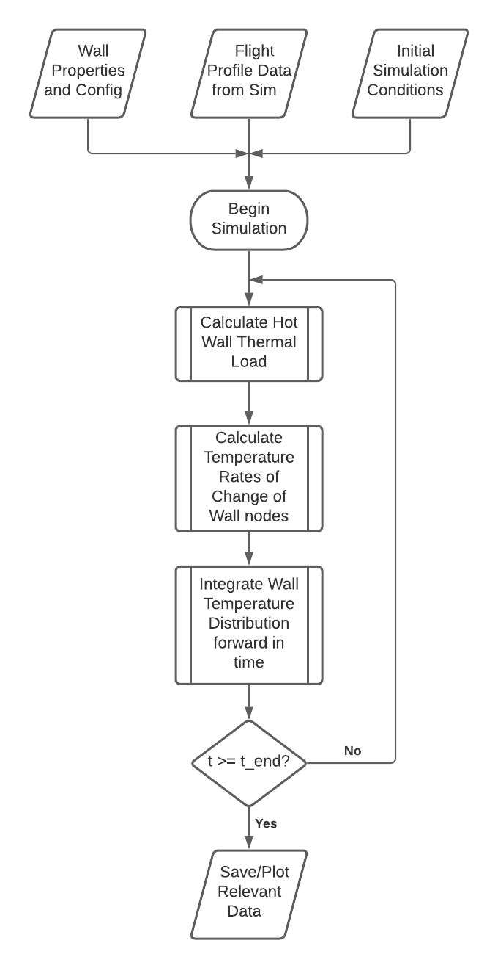
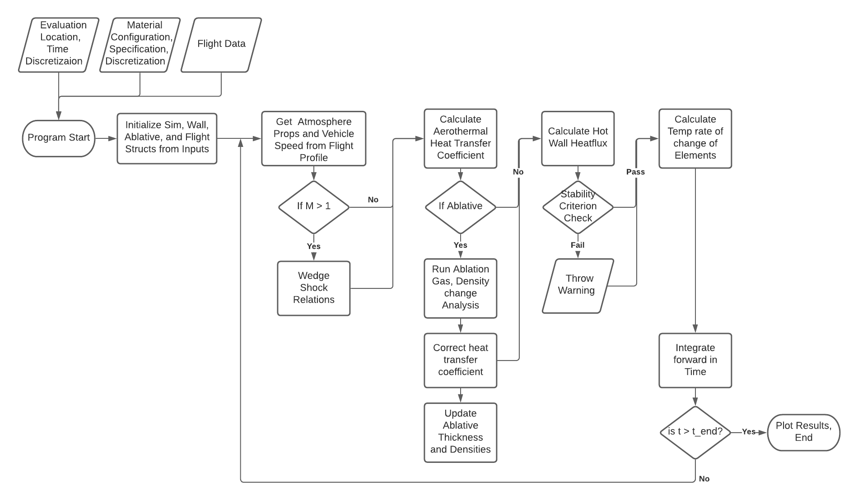
Structure/Flowchart

Slide 30
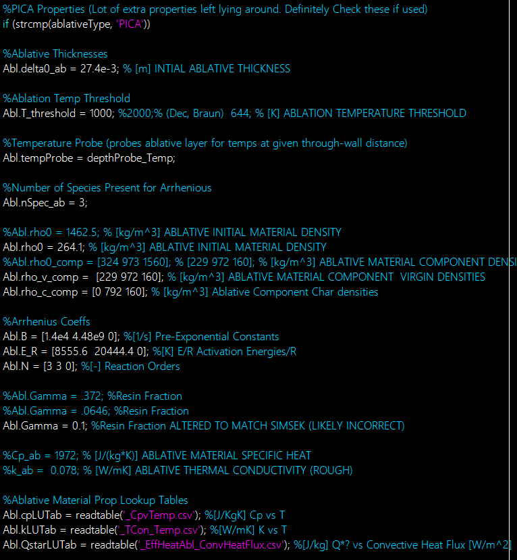
Material Specification

